Slide 1
Software Development and Hardware Commissioning for Applications in the High Contrast Imaging Testbed Facility
Eric Lin
Mentors: Hong Tang and Camilo Mejia Prada

Slide 2
Introduction
Who?
Myself, with help from Hong Tang, Camilo Mejia Prada, Keith D. Patterson, Pin Chen, and many more!
What?
Work on coronagraph testbeds, their instruments, and the vacuum chambers around them
When?
May 14th – July 19th, 10 week program
Where?
High Contrast Imaging Testbed Facility (HCIT)
Why?
To learn new skills and gain some real-life experience
To help further our ability to study planets beyond our solar system

Slide 3
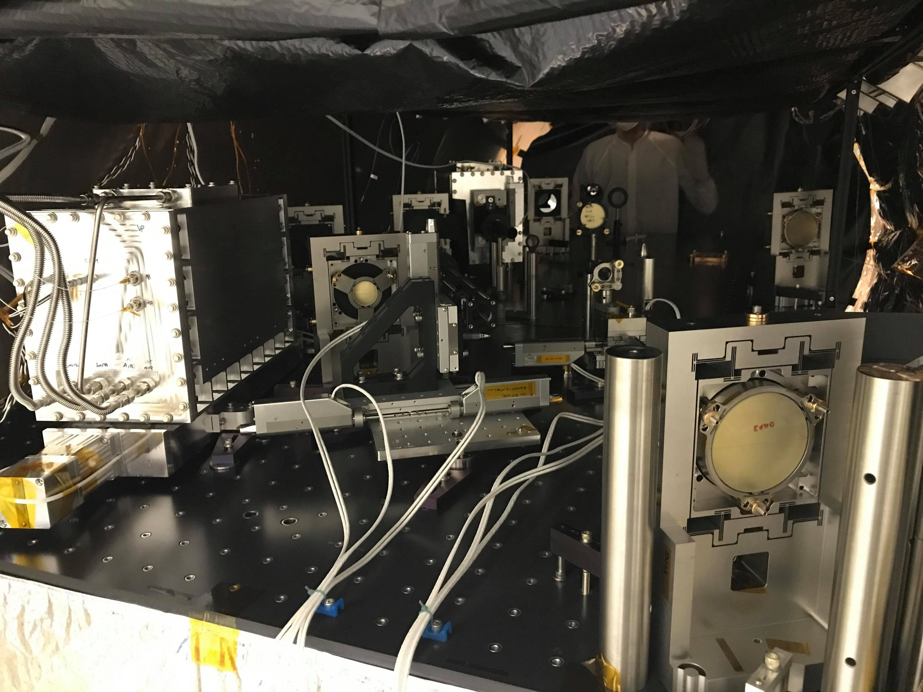
Background
What are coronagraph testbeds?
“Million dollar LEGO sets”
Testing new coronagraph technologies and techniques
What are coronagraphs?
Instrument used to block out direct starlight
Originally developed to study the corona of the Sun
Why do we need them?
Can be used to observe/study exoplanets
Stars are bright, planets are dim
Life beyond our solar system?

Slide 4
Main Project Tasks:
Task 1: Designing and installing a turbo vacuum pump safety system
Task 2: Installing the Decadal Survey Coronagraph Testbed (DST)
Task 3: Tuning the DST’s thermal heater PID controllers
Task 4: Calibrating a Deformable Mirror (DM) mount
Task 5: Mounting, Calibrating, and installing a DM

Slide 5
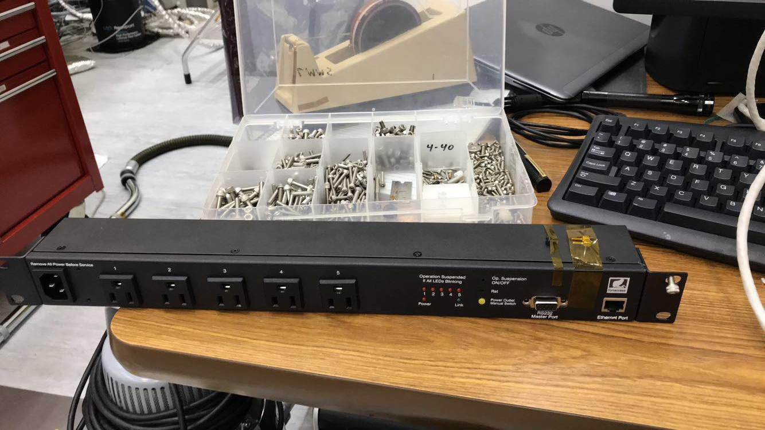
Task 1: Turbo Vacuum Pump Outlet Control (TVPOC)
Controls a smart power strip/outlet that a turbo pump and its gate valve will be connected to
TVPOC polls the pressure transducer 1 time per second, also pump speed/temp if the new pump comes in soon
If TVPOC detects an error while polling (e.g. pressure too high), TVPOC remotely turns off the outlet the gate valve is connected to
Turbo pump is designed to automatically shut the gate valve when power is lost, sealing the chamber. Only works when there is enough air pressure in the pump lines.
Smart power strip for TVPOC

Slide 6
Task 1: TVPOC (Cont.)
START
LOOP
User calls tvpoc.py
END
Keyboard Interrupt
Date/time of stop logged
Date/time of start logged into tvpoc_log.txt
Pressure is polled from pressure transducer
Program sleeps for *1 second
Pressure Normal
Pressure Too High
Command sent to shut off turbo pump gate outlet
Turbo pump loses power, gate valve closes
* Can be adjusted based on how quickly an error needs to be caught

Slide 7
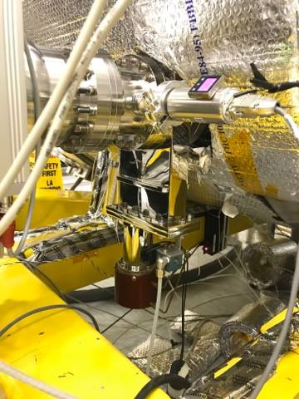
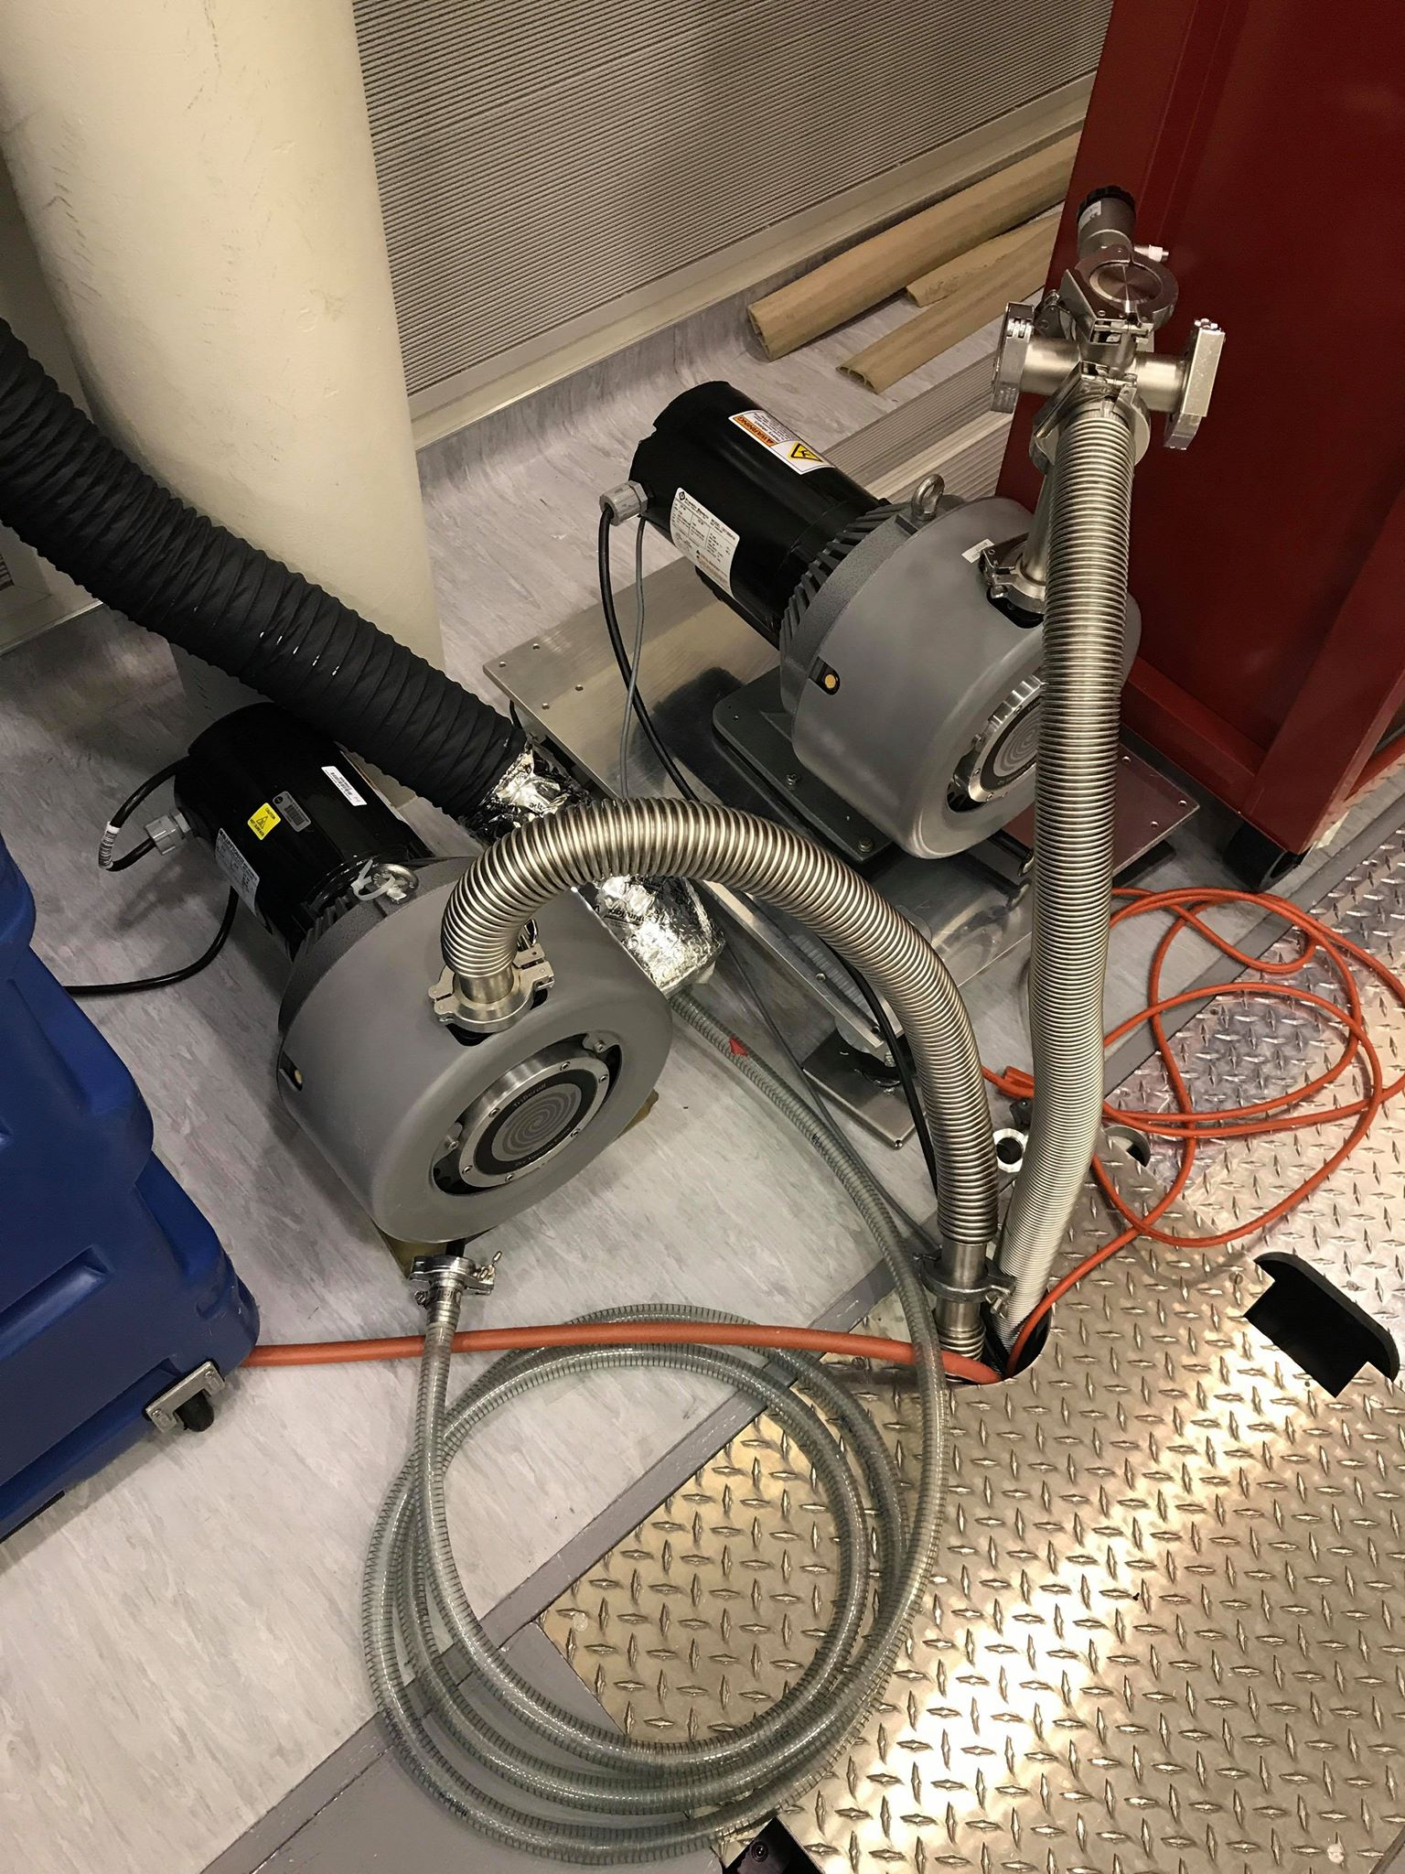
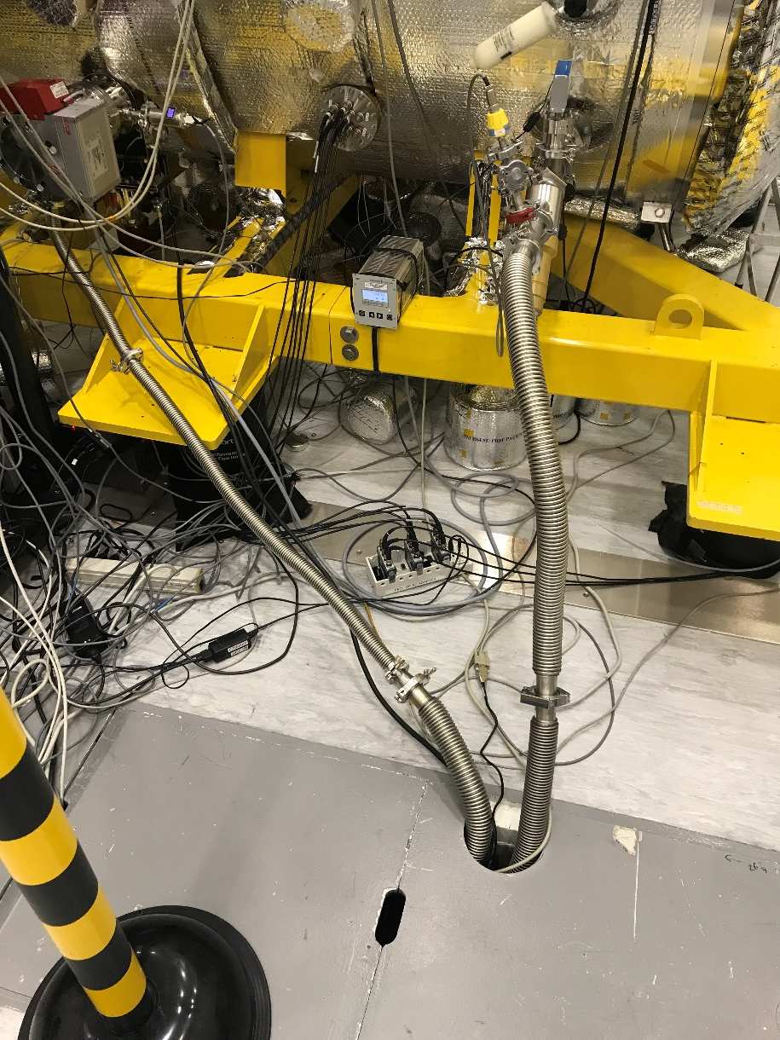
Task 1: TVPOC (Cont.)
Come up with design of system alongside Camilo
Find and order necessary hardware
Figure out how to communicate with new hardware
Install new hardware
Test and debug various issues
Present system and receive feedback
Alter system design and apply changes
Implement new system into existing Watchdog
Turbo Gate Valve of HCIT1
New setup of the turbo pump
Backing pump originally located
next to the turbo pump

Slide 8
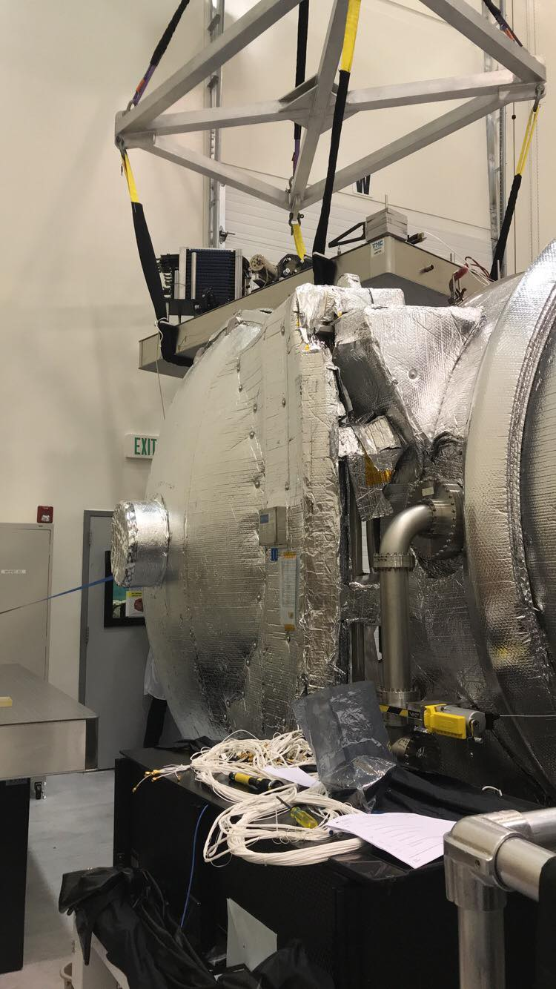
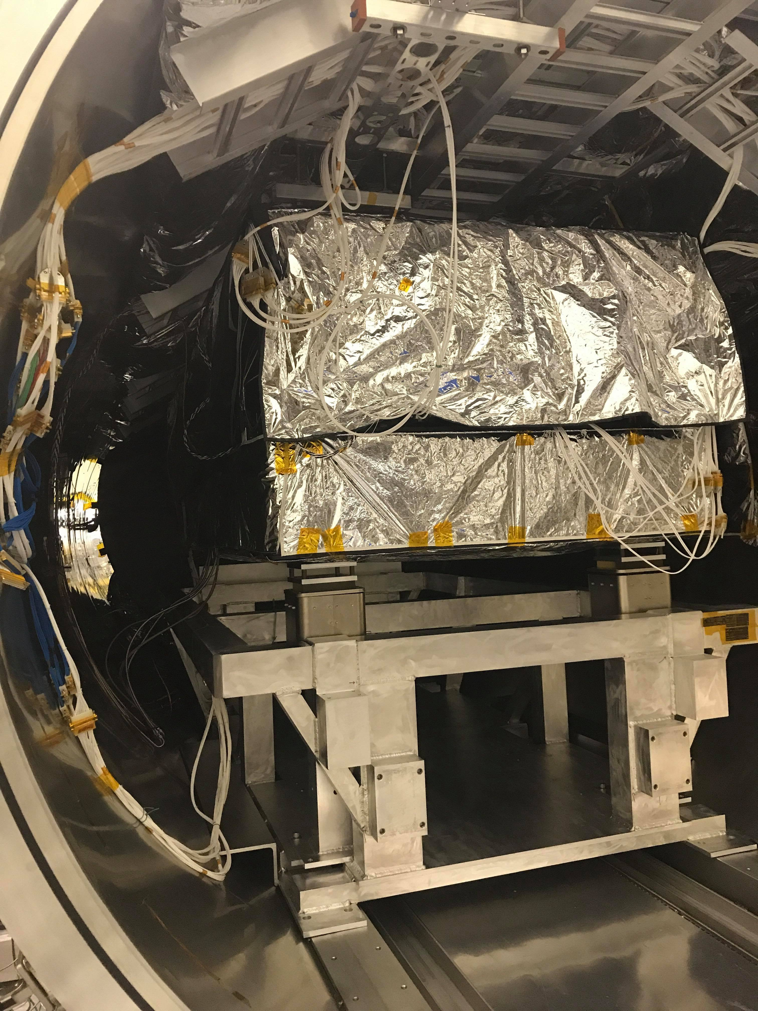
Task 2: Installing DST
Moving DST into chamber
D-Sub cabling all the motors
Taping up wires
Installing heaters and thermal sensors
Untangling, coiling, recoiling, optical fibers
Balancing the table floaters
Installing coolant lines
Testing everything

Slide 9
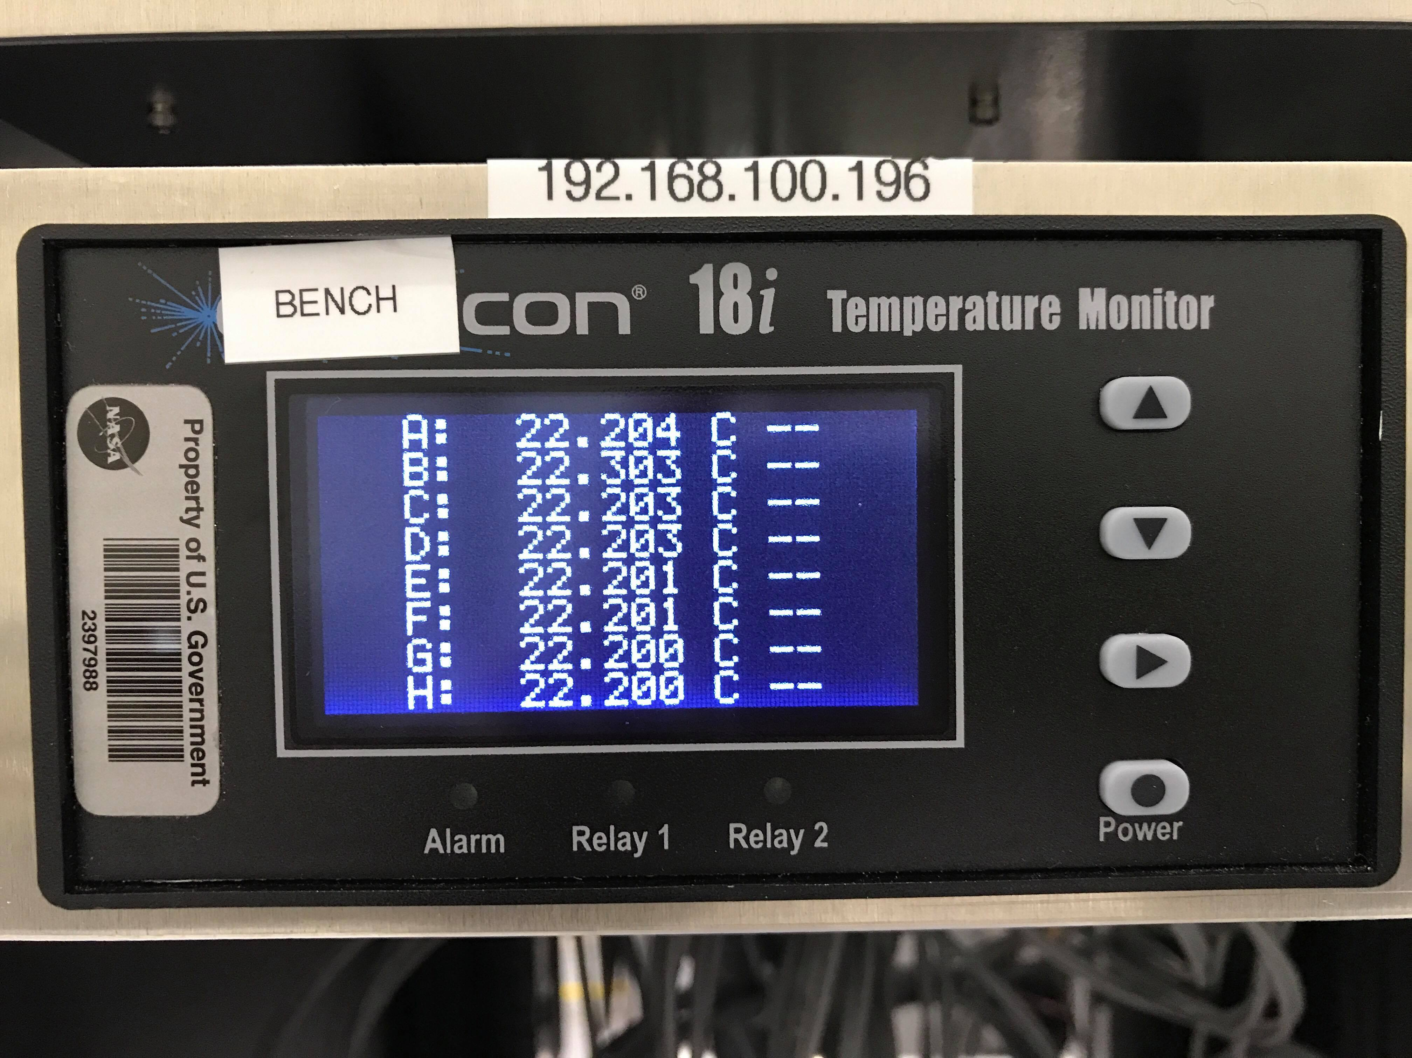
Task 3: Tuning DST thermal PID controllers
PID Control = Calculate error from setpoint given parameters
Working with MATLAB GUI
Estimated P values through manual testing
Found to be extremely high, much higher than expected
Calculated I and D using P
Values led to uncontrolled behavior
Bug found in C script while debugging another issue
Fixed!

Slide 10
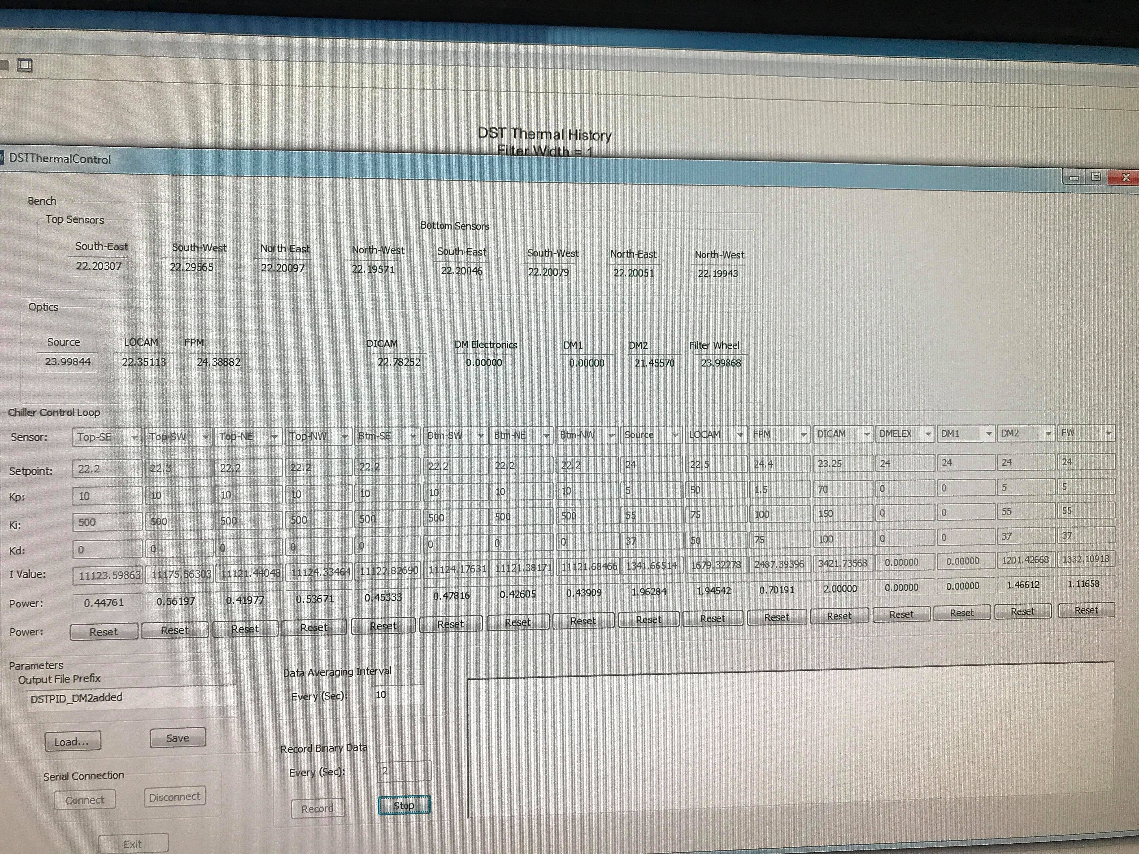
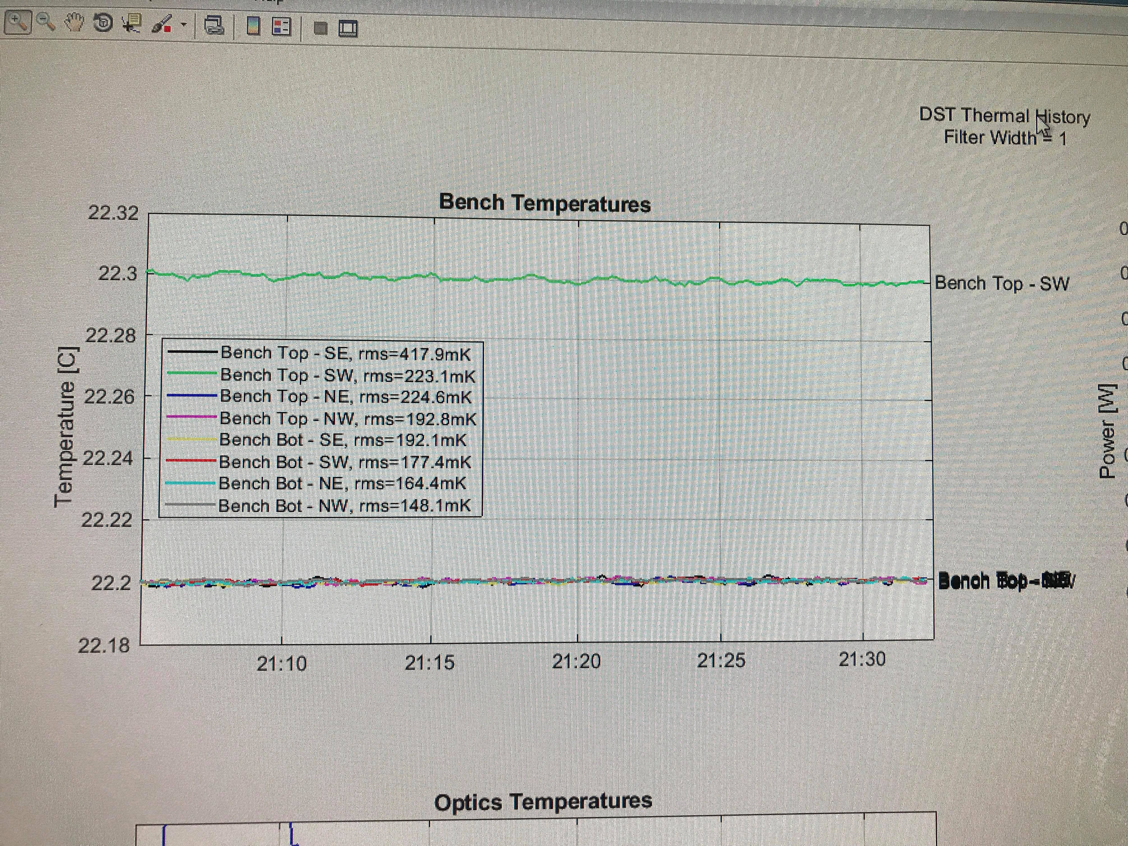
Task 3: Tuning DST thermal PID controllers (Cont.)

Slide 11
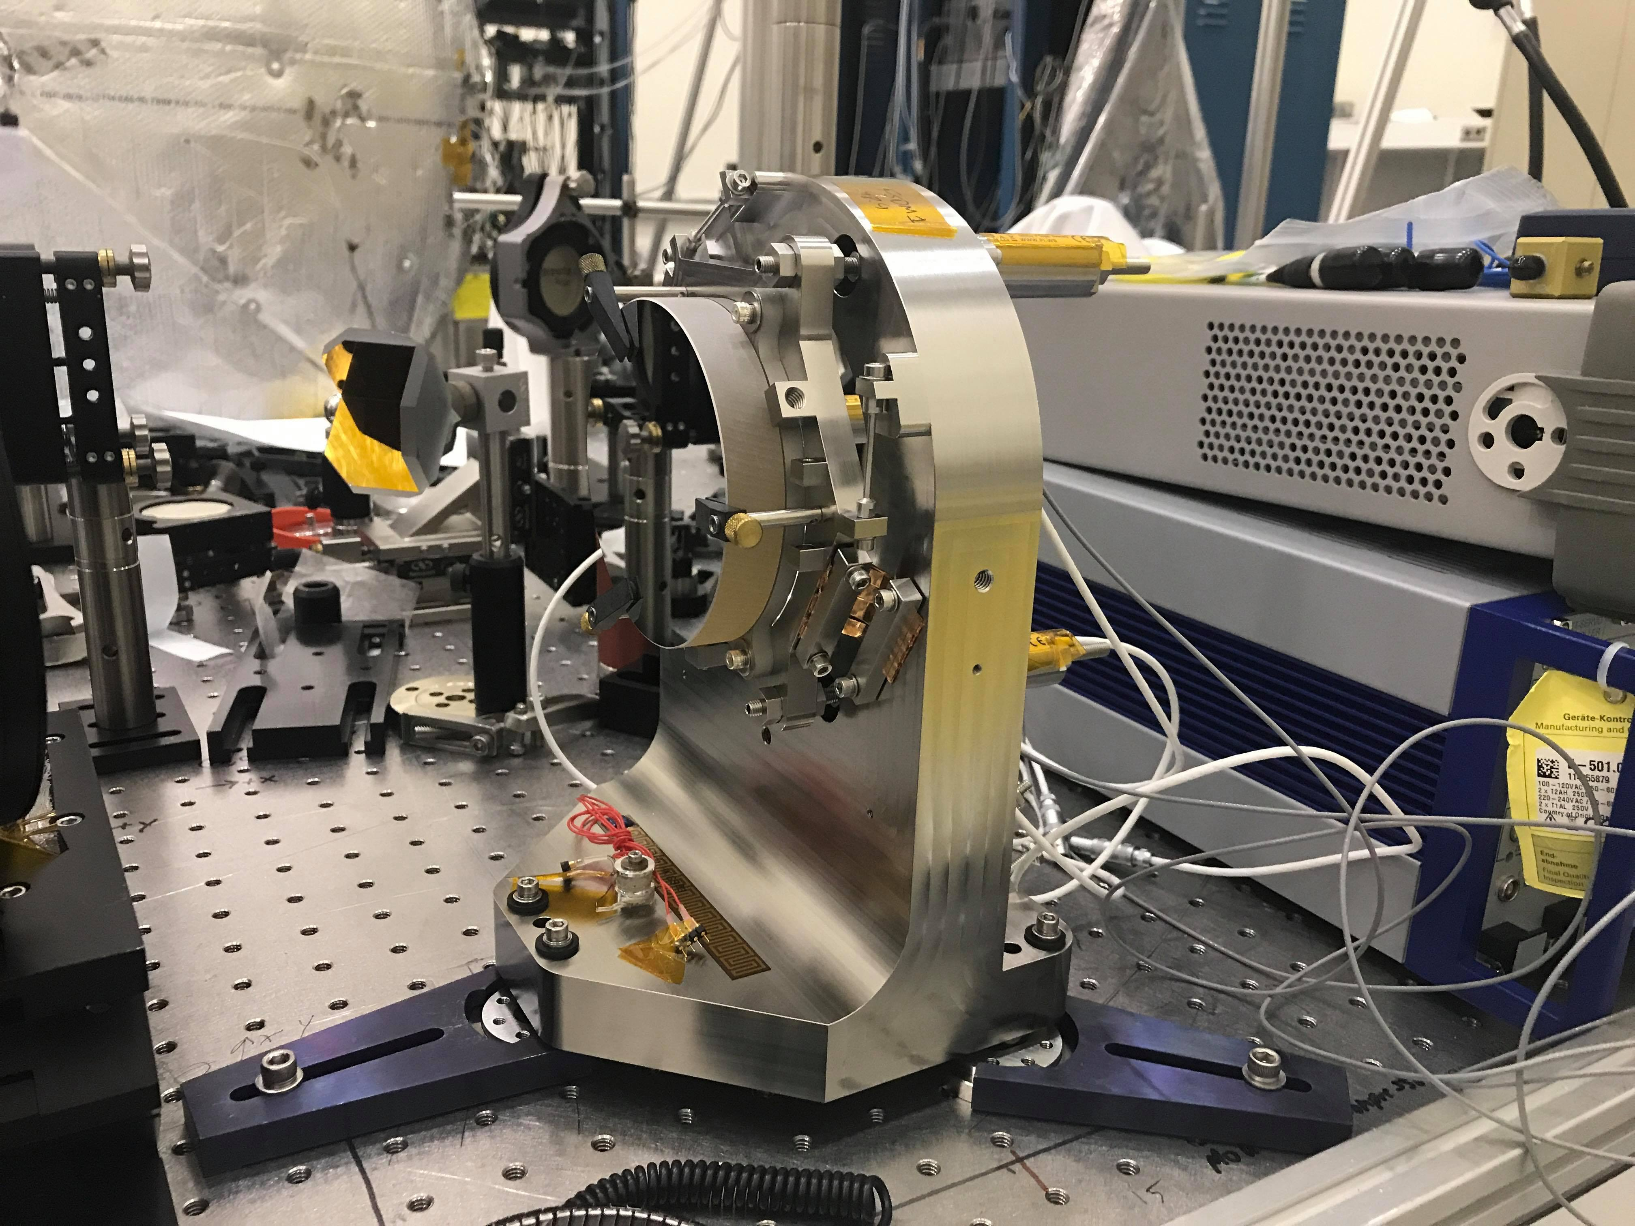
Task 4: Calibrating a DM mount
Characterizing voltage controlled crystal piston motors
Controls tilt of mirror (very fine)
Used interferometer to measure tilt
Used dummy mirror so I don’t get blacklisted
Originally intended to use polished steel plate
Switched to aluminum mirror
Cycled voltages through motors
Left to do:
Calibrate strain gauges to eliminated hysteresis (lag)
Determine modal frequencies (vibrations) of mount

Slide 12
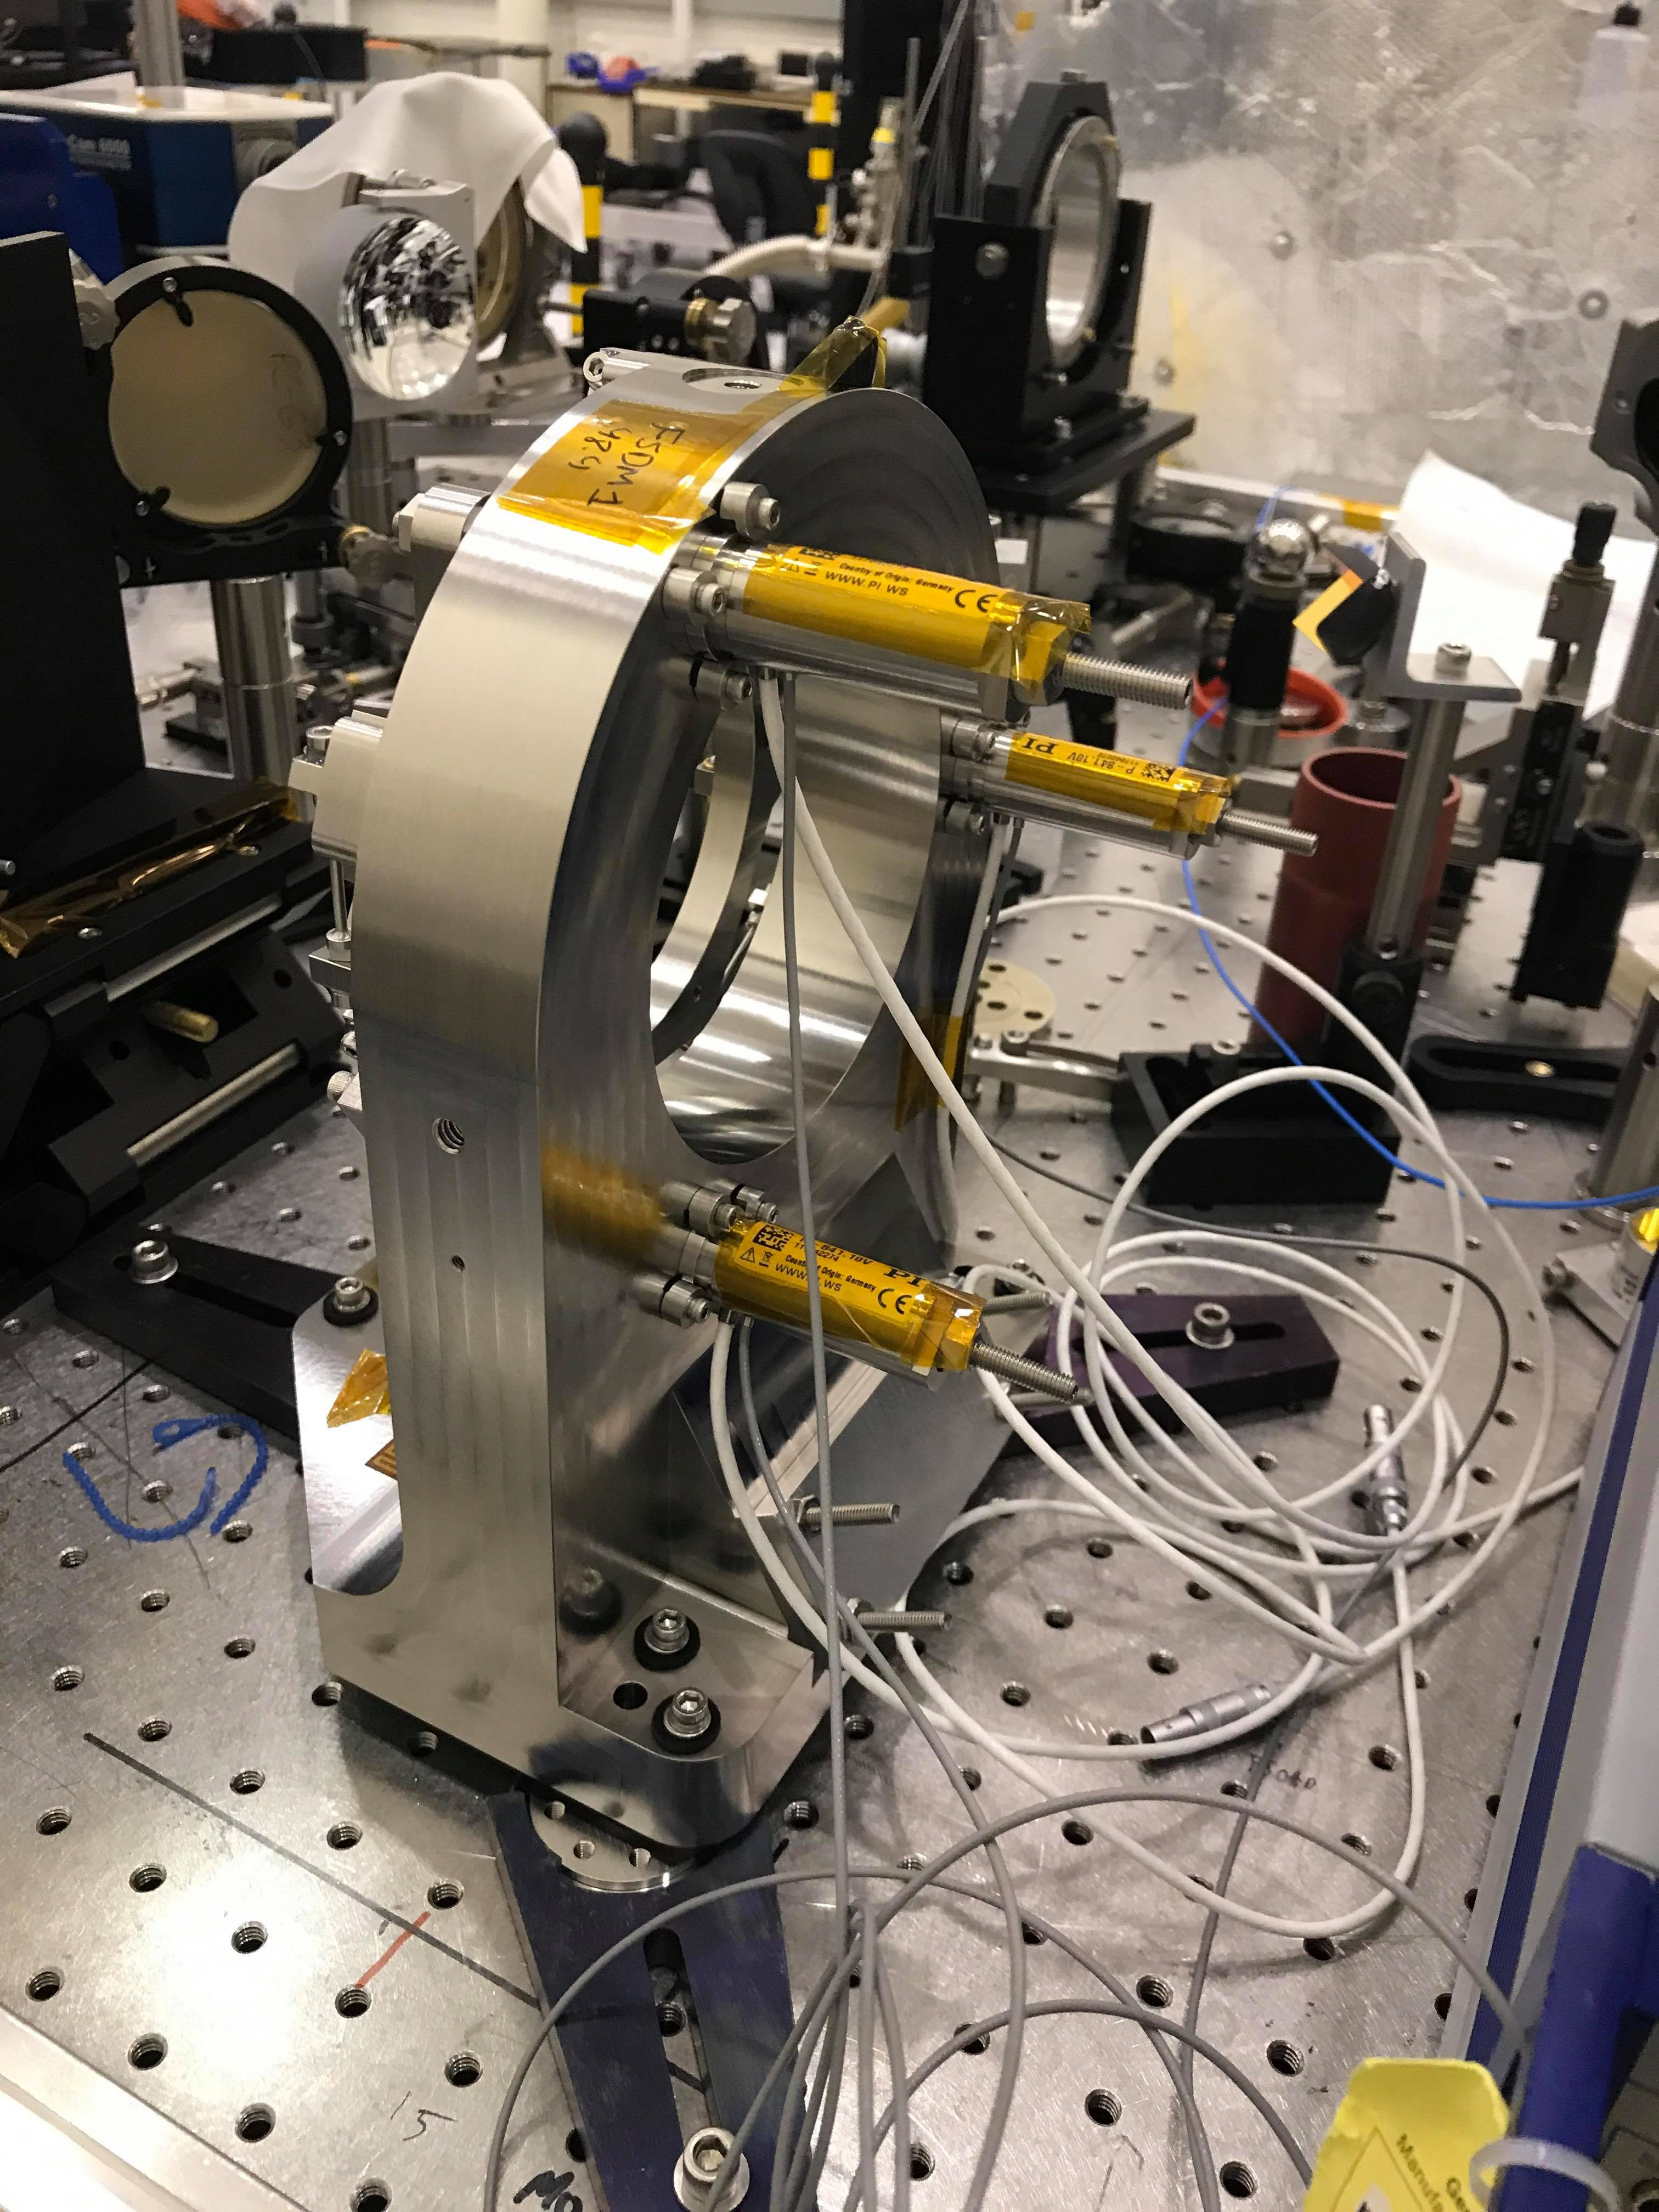
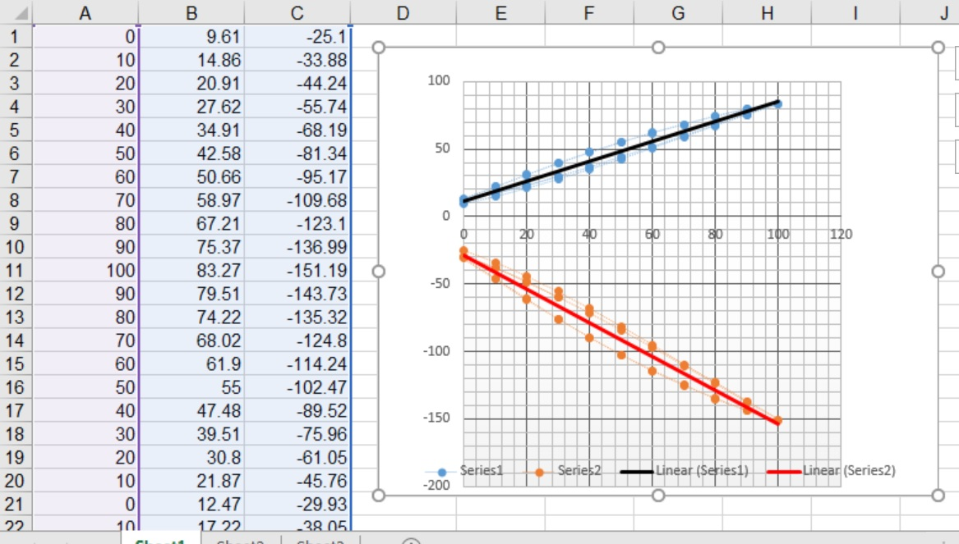
Task 4: Calibrating a DM mount (Cont.)

Slide 13
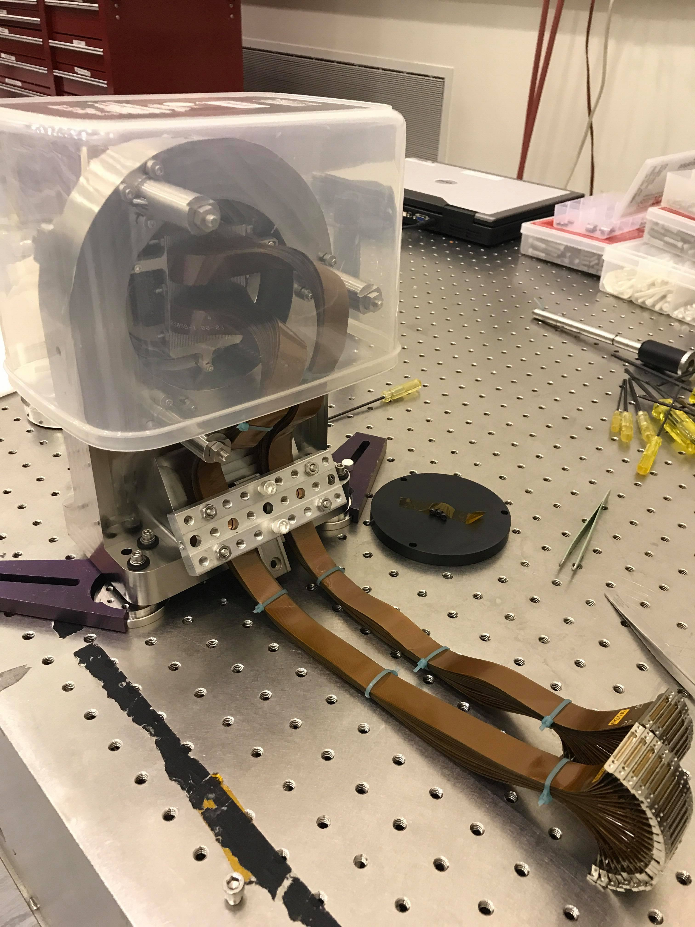
Task 5.1: Mounting a DM
A lot more frustrating and tedious than it should have been
Strain reliever too thick
Good tape type ran out
Copper strips for thermal conductivity
Working with JCI
Lots of on the fly problem solving and improvising
Learned a lot for next time

Slide 14
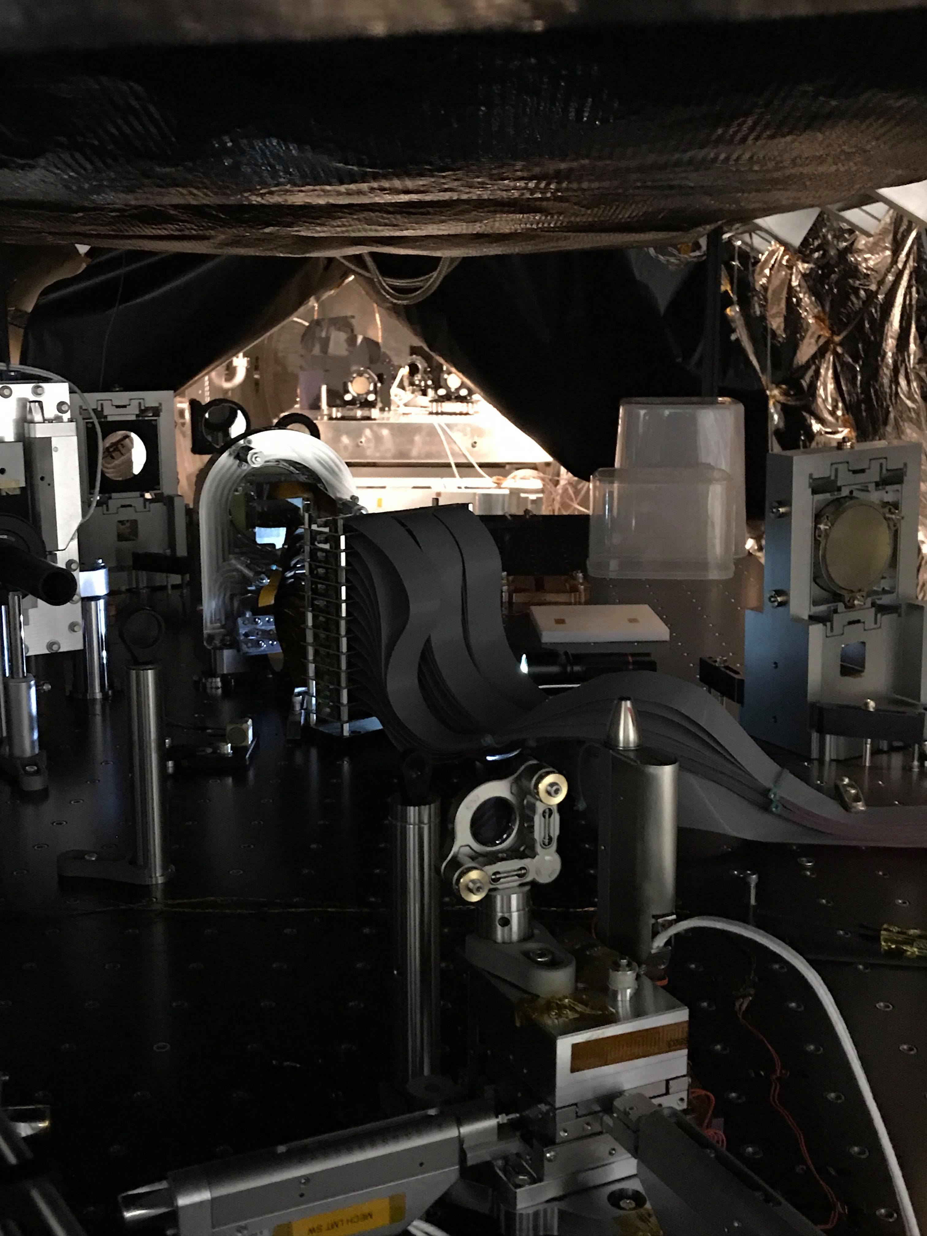
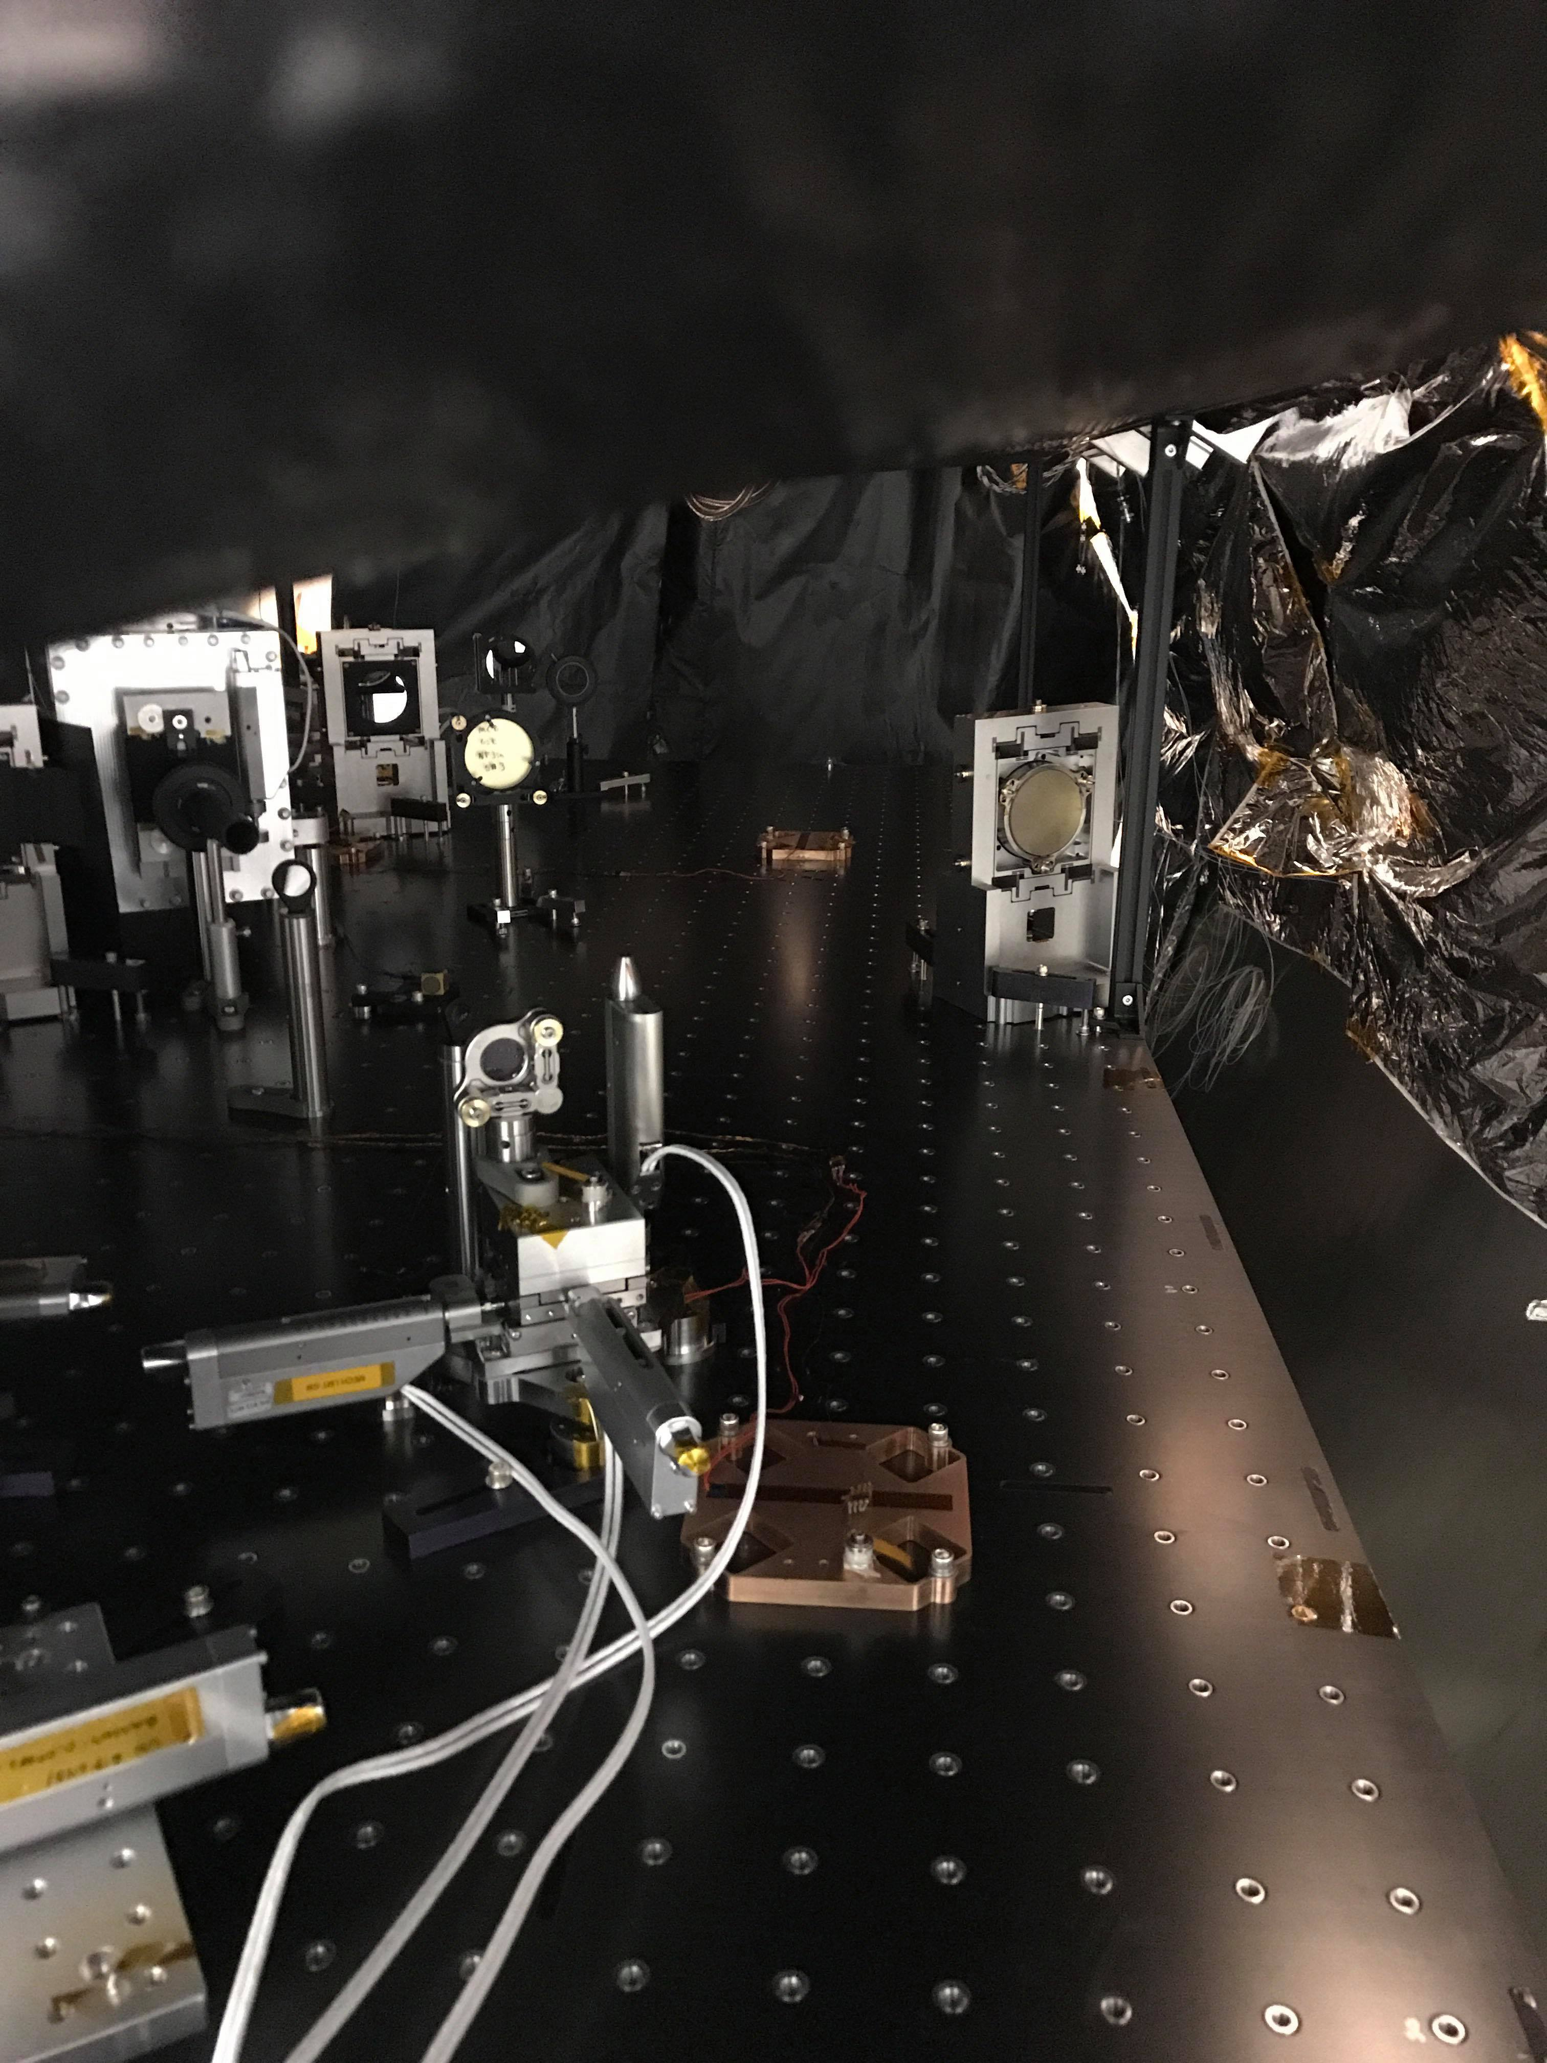
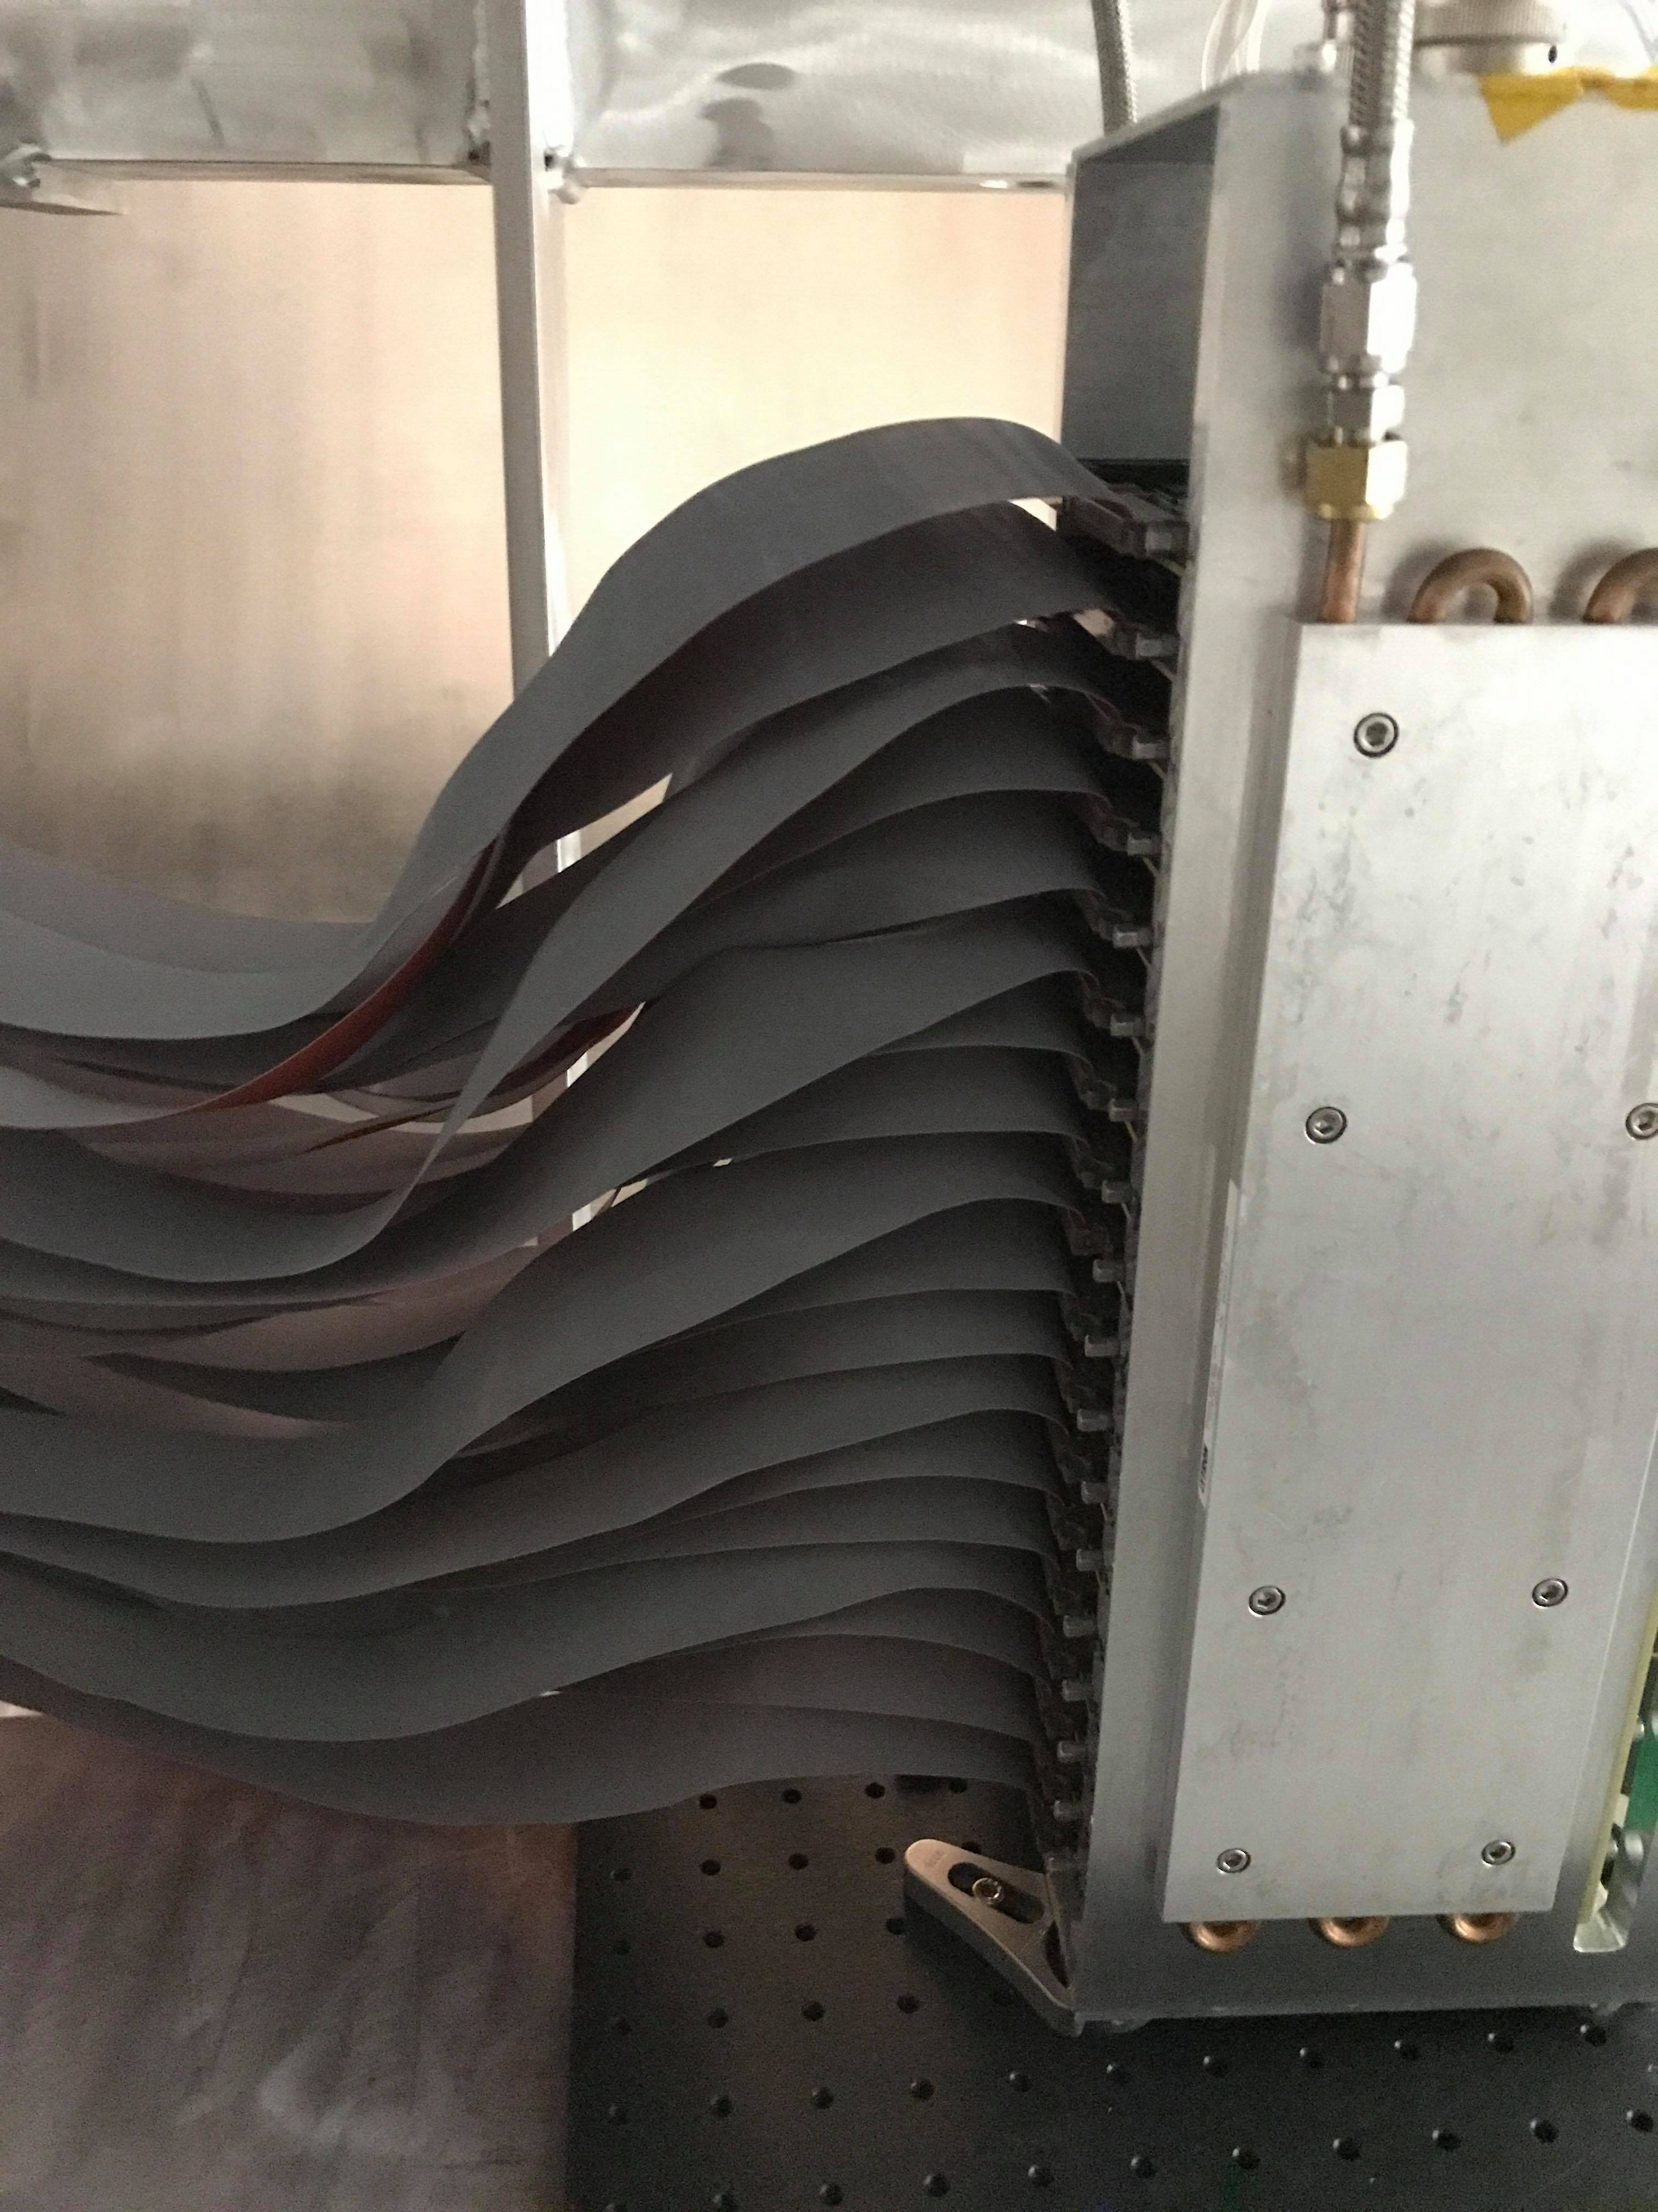
Task 5.2: DM Installation
Preparation of all components
Connecting cables
Working on cooling system

Slide 15
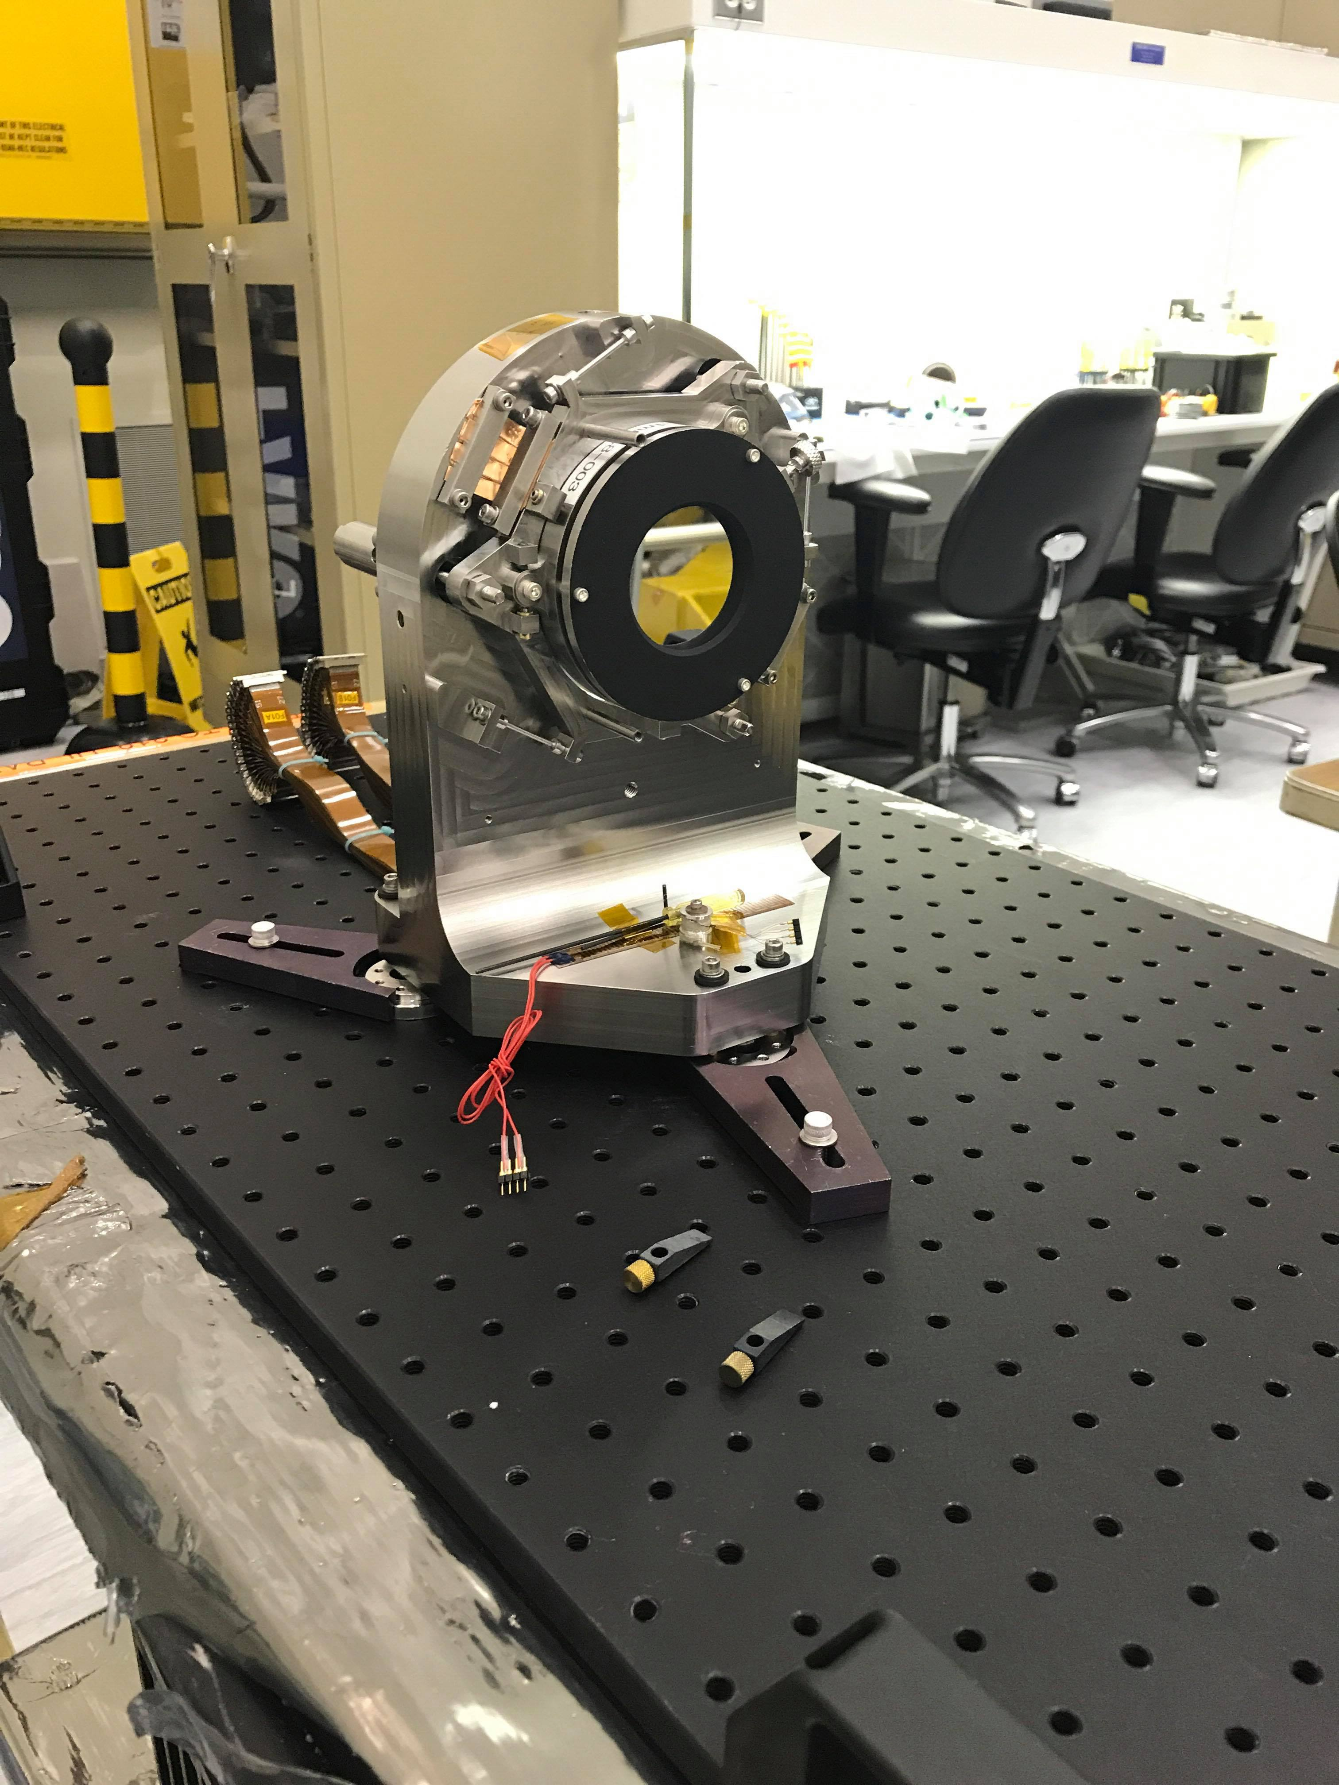
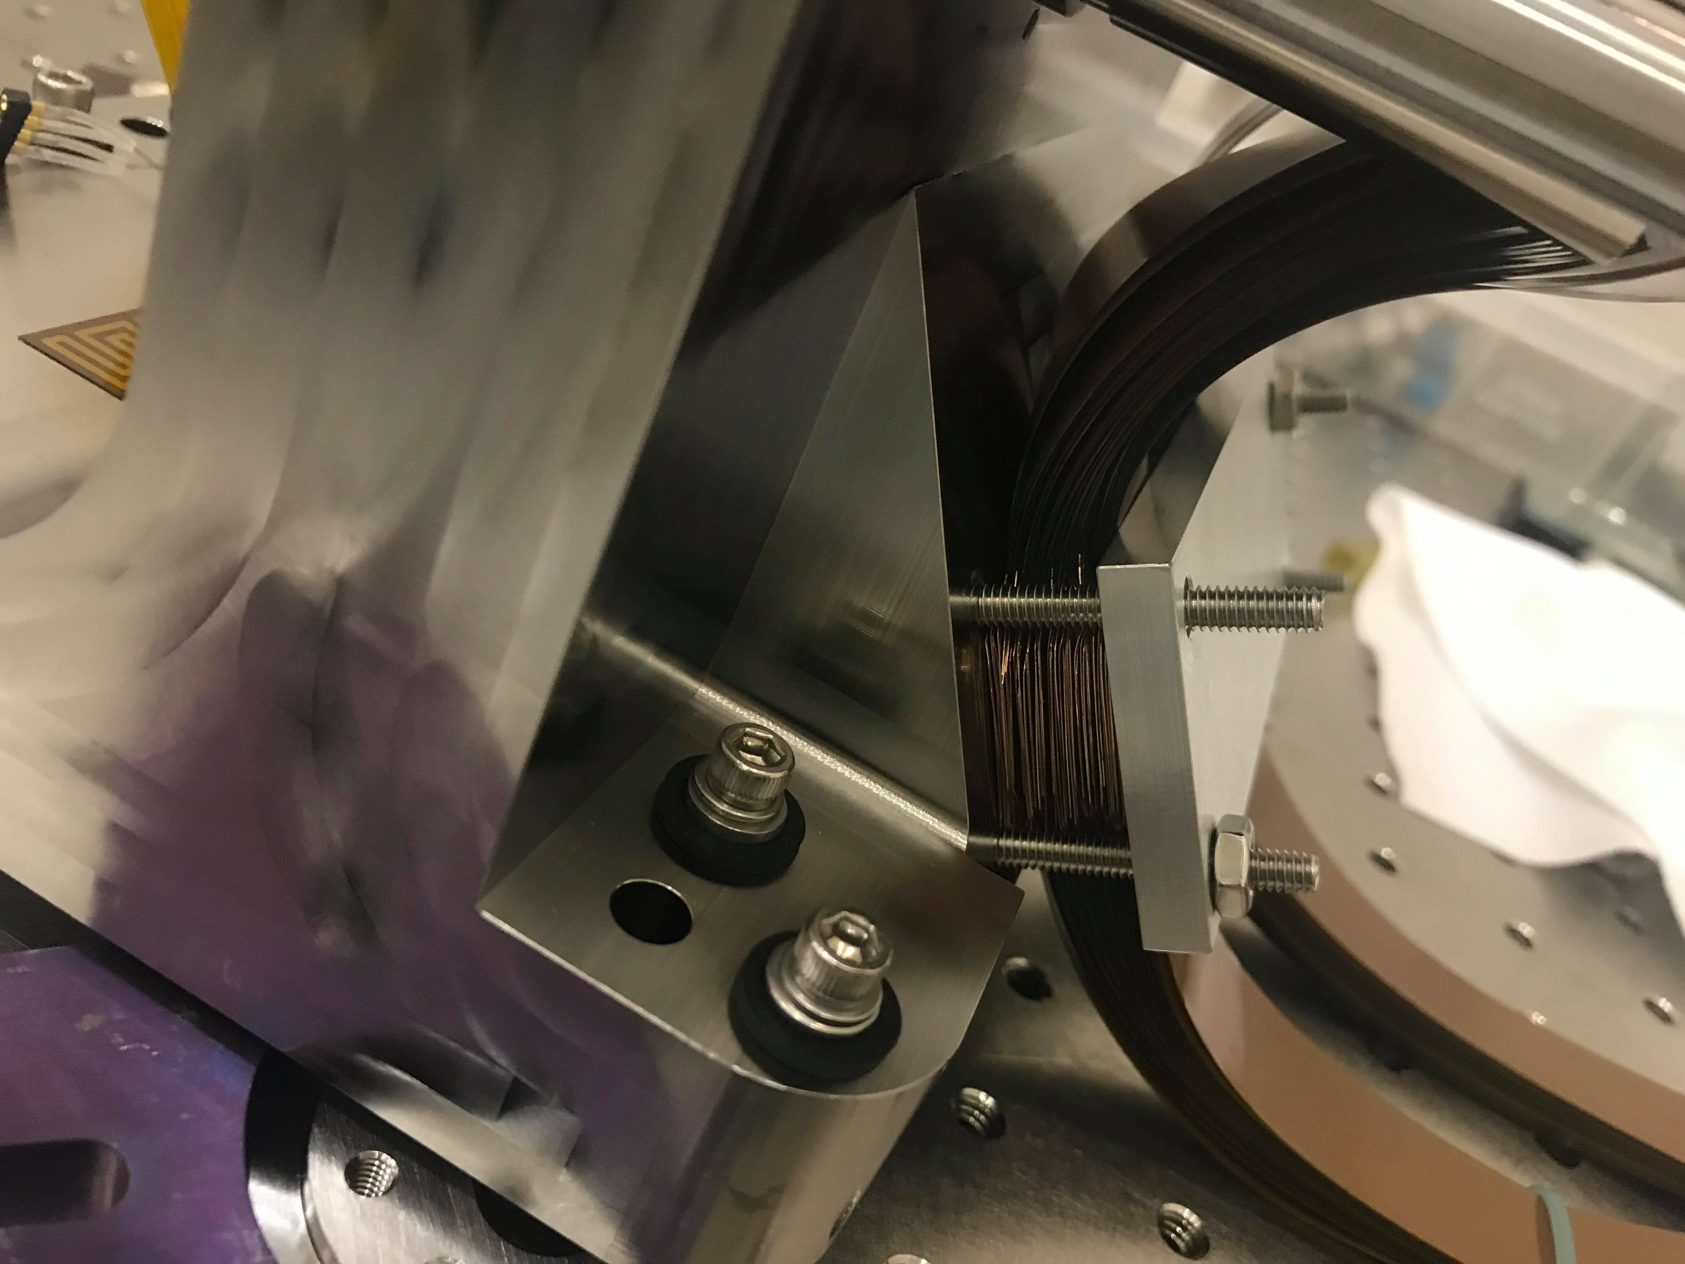
Task 5 Pictures (Cont.)

Slide 16
Acknowledgements
Hong Tang
Camilo Mejia Prada
Keith D. Patterson
Pin Chen
All of the HCIT team

Slide 17
Thank You For Listening!

